Slide 1

Serial Peripheral Interface
8-bit data, mode-0

Slide 2
Presenters
Muhammad Talha Ayyaz 2023-EE-174
Anas 2023-EE-136?
Abdullah Chaudhary 2023-EE-168
Shaheman 2023-EE-178
Presented To
Miss Shehzeen Malik

Slide 3

SPI
Reading
3-Axis Accelerometer
On Nexys A7 100t
Using
System Verilog

Slide 4



Communication Protocols
Set of Rules for Communication
Ensures correct and reliable data exchange
Used in networking, embedded systems, IoT, etc.
Why do we need protocols?
Synchronization between devices
Data integrity
Speed and efficiency

Slide 5
Types of Protocols
Parallel
Series
Multiple bits sent simultaneously over multiple wires
Faster (more bits per clock cycle)
Short-distance, high-speed transfers
e.g., data bus inside microcontrollers
Bits sent one after another on a single wire
Slower per clock cycle, but high-frequency makes it efficient.
Cheaper and ideal for long distances.
UART, SPI, I2C, USB, Ethernet
0101111011001101

Slide 6
Types of Protocols
Synchronous
Asynchronous
Sender & receiver share a common clock
Data is sent in sync with clock pulses
Faster for continuous data
SPI, I2S, USART (in sync mode)
Sender & receiver use start/stop bits
Self-timed
Slightly slower due to extra bits
UART, RS-232, USB (partially async)

Slide 7
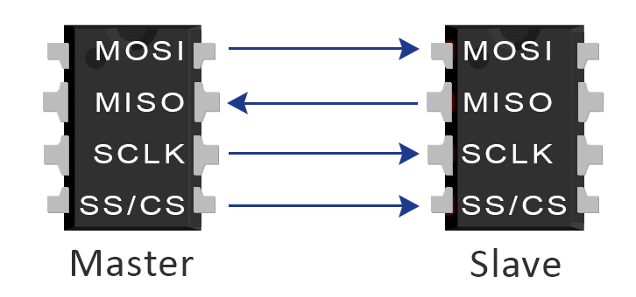
Serial Peripheral Interface
Full-duplex, synchronous serial communication protocol
Master-slave based
Uses 4 main lines: MOSI, MISO, SCLK, SS/CS
Great for high-speed short-distance communication

Slide 8
Serial Peripheral Interface
SPI Lines:
1. MOSI – Master Out Slave In
2. MISO – Master In Slave Out
3. SCLK – Serial Clock (from Master)
4. SS/CS – Slave Select / Chip Select
(Active LOW)
Roles:
Master: Controls clock and initiates communication
Slave: Responds to master's clock and data

Slide 9
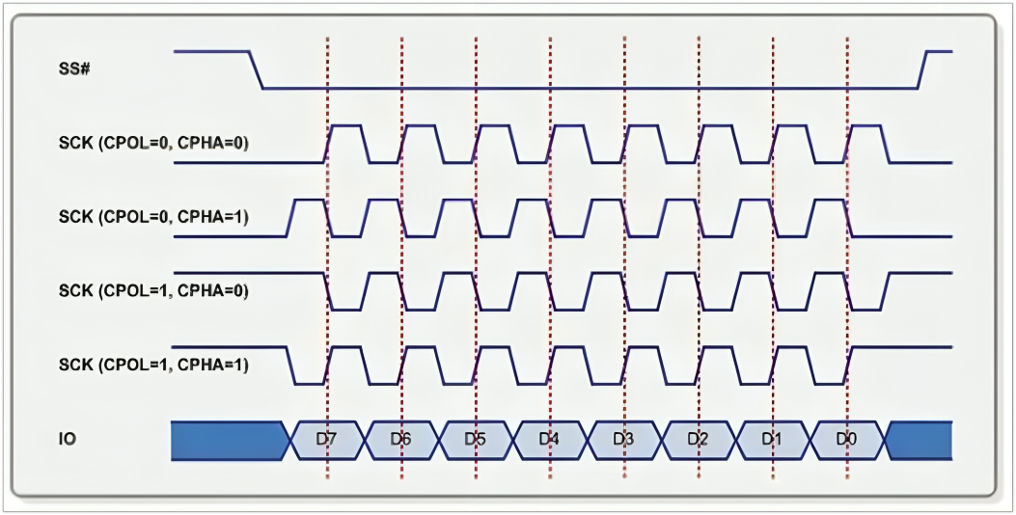
SPI Modes

Slide 10
CPOL = 0 idle state is 0

Slide 11
CPOL = 1 idle state is 01

Slide 12
CPHA= 0 phase is 0

Slide 13
CPHA= 1 phase is 180

Slide 14
SPI
Reading
3-Axis Accelerometer
On Nexys A7 100t
Using
System Verilog

Slide 15
High Level Architecture
Nexys A7
(Master)
ADXL362
(Slave)
SPI Bus

Slide 16
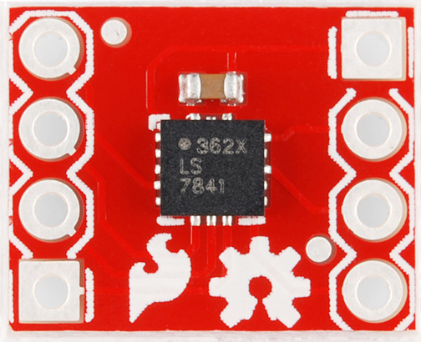
ADXL362
It’s a 3-axis accelerometer → It measures acceleration in X, Y, Z directions.
Power Efficient
Always gives 12-bit resolution (accurate!)
Also provides 8-bit format (for smaller data if needed)
±2g, ±4g, or ±8g depending on config
Data available in dedicated registers:
XDATA, YDATA, ZDATA

Slide 17
ADXL362 Working
1. Command Format (1-byte opcode + data):
Command | Opcode | Description
READ_REG | 0x0B | Read register
WRITE_REG | 0x0A | Write register
FIFO_READ | 0x0D | Read FIFO data
Mode | Description
Standby | Default state after reset
Measurement | Actively sampling acceleration
Wake-up | Low-power motion detection mode
Auto Sleep | Automatically switches to standby

Slide 18
Command Format
The command format for ADXL362 is like
[Command] [Register Address] [Data (optional)]
Register Addresses
Address | Name | Description
0x08 | XDATA | X-axis data
0x09 | YDATA | Y-axis data
0x0A | ZDATA | Z-axis data

Slide 19
How to read Data
Read X-axis 8-bit
MOSI: 0x0B 0x08 0x00
Output is
MISO: -- -- 0xXX
This 0xXX is 8-bit signed data ----- Value of acceleration

Slide 20
High Level FSM
idle
Send data
Receive data
Process data

Slide 21
The End

